Slide 1
Compare sequences to construct a phylogenetic tree
By Gopalakrishnan Kumar, MTech IIT-Bombay,
Freelance Data Science Consultant, GLV Data Solutions Consultancy.
LinkedIn: Profile Link :
https://www.linkedin.com/in/gopalakrishnankumar-a73301110/
Github:
https://www.github.com/Gopalakrishnan-Kumar/
Kaggle:
https://www.kaggle.com /gopalkk2

Slide 2
Google Colab URL
https://colab.research.google.com/drive/1OmD7CTgKgYHXvippaG2nlZRAqouZg-eb?usp=sharing

Slide 3
Objective
To compare DNA sequences and construct a phylogenetic tree to explore evolutionary relationships between sequences
.
Input Data
File: input.fasta Content: 3 nucleotide sequences

Slide 4
Methodology
Sequence Alignment
Tool: Clustal Omega
Sequences are aligned to identify regions of similarity.
Gaps are introduced where necessary to optimize alignment.
Alignment output is saved to aligned_file.fasta.

Slide 5
Methodology
Distance Calculation
Tool: Biopython DistanceCalculator (identity)
Computes pairwise distances between aligned sequences.
The identity method calculates the proportion of matching nucleotides.

Slide 6
Methodology
Tree Construction
Method: UPGMA (Unweighted Pair Group Method with Arithmetic Mean)
A hierarchical clustering algorithm used to create a rooted tree.
Distance matrix is converted into a dendrogram structure.

Slide 7
Methodology
Visualization
Tool: Biopython Phylo + Matplotlib
The final tree is rendered graphically.
Branch lengths indicate evolutionary distances.

Slide 8
Results & Interpretation
 | seq1 | seq2 | seq3
seq1 | 0.00 | 0.87 | 0.83
seq2 | 0.87 | 0.00 | 0.80
seq3 | 0.83 | 0.80 | 0.00
seq2 and seq3 are more closely related than either is to seq1.
All three sequences are similar, indicating relatively recent divergence.

Slide 9
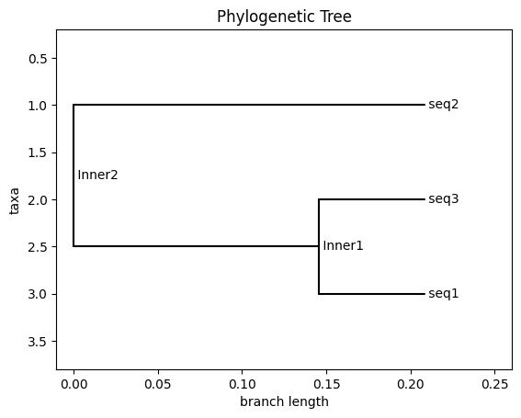
Results & Interpretation

Slide 10
Conclusion
The phylogenetic tree successfully illustrates the genetic relationships between sequences.
Clustal Omega + Biopython provide an effective pipeline for bioinformatics analysis.
Such trees are valuable in evolutionary biology, taxonomy, and gene function prediction
.

